Slide 1
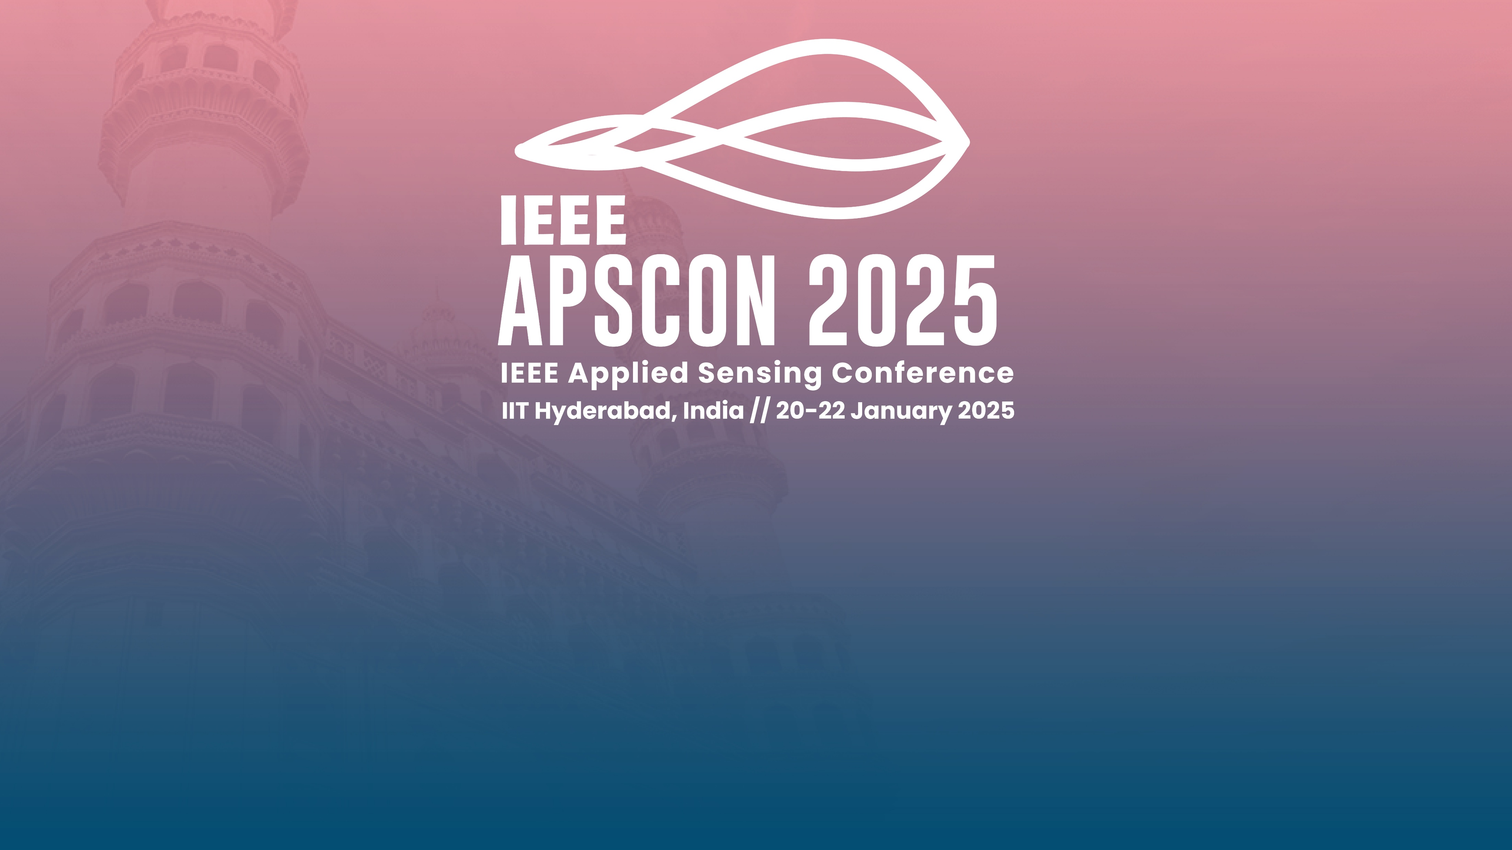


Meta-Learning Based Continual Learning Methods for Fine-Grained Fruit Quality Classification
Authors: Prathamesh Gadekar, Aayush Mishra, Dr. Parijat Deshpande and Dr. Manasi Patwardhan

Slide 2

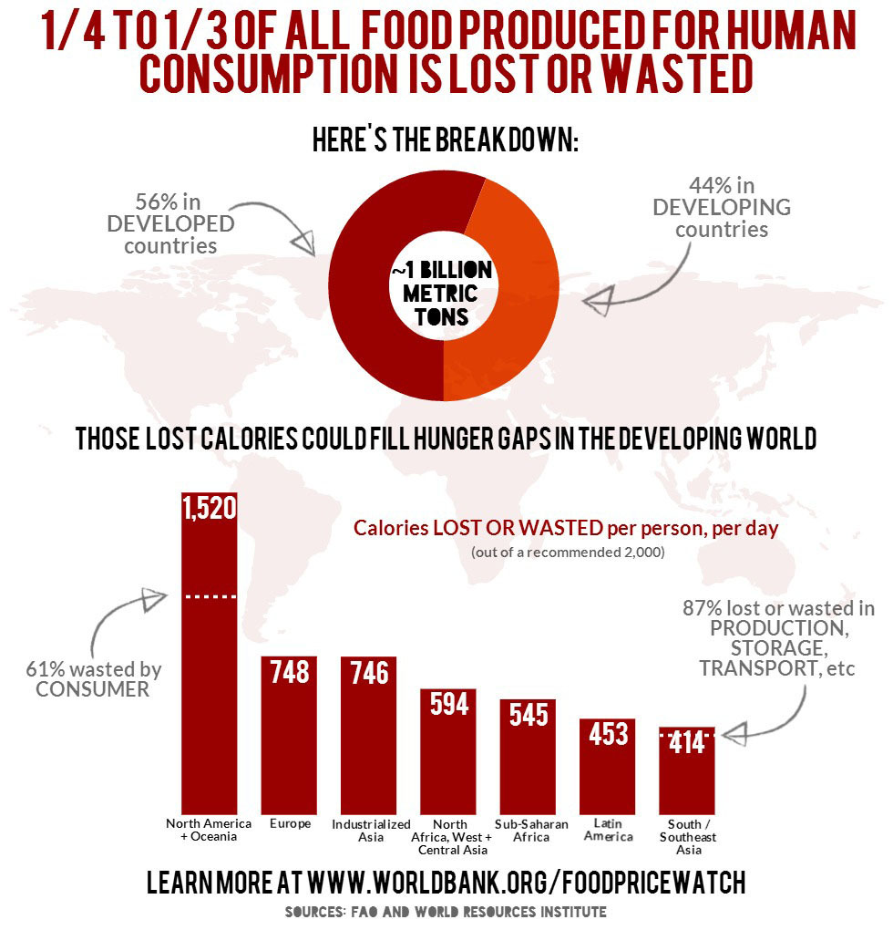
Motivation
87% waste occurs in production, storage, and transport in South Asia.
1/4 to 1/3 of all food produced is lost or wasted (~1 billion metric tons) globally.
Food Wastage Statistics [1]

Slide 3
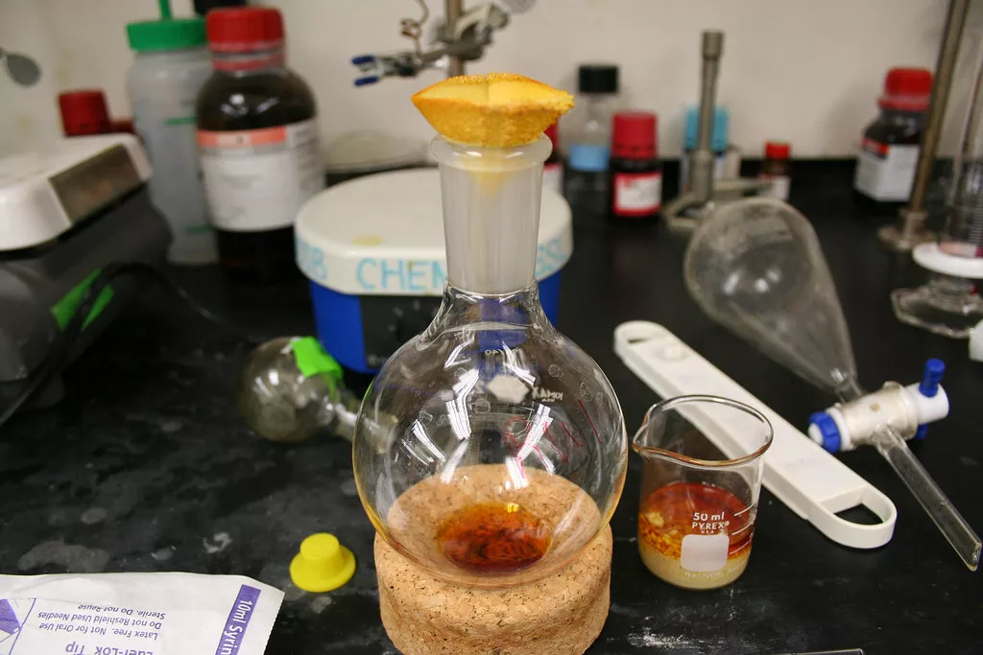
Methods for Assessing Food Quality
Invasive:
Physically alters food, accurate but impractical for large-scale operations. Example: Chemical Analysis
Non-Invasive:
Based on external characteristics like colour and texture, suitable for real-time and cost efficient but less precise.
Example: Deep Learning based methods.
https://www.thoughtco.com/simple-chemical-tests-for-food-4122218

Slide 4
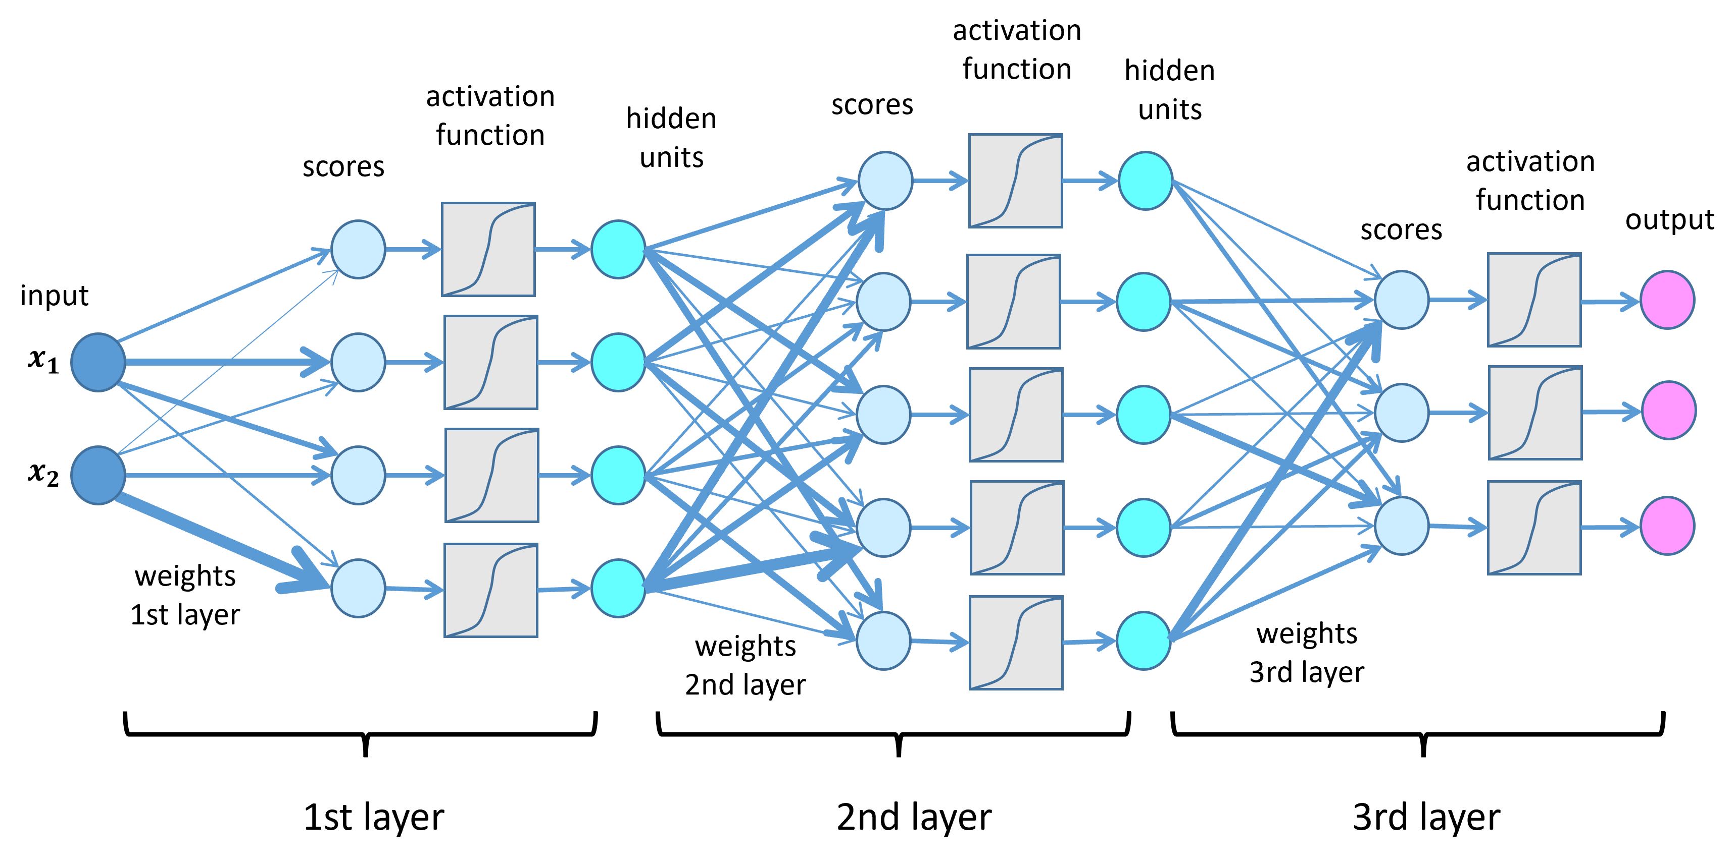
Drawbacks of Traditional Deep Learning
Large dataset requirements.
Assumption of I.I.D data.
Fruit-specific models with poor generalization.
OUR WORK FOCUSES ON OVERCOMING THESE DRAWBACKS.
Deep Learning Architecture [2]

Slide 5
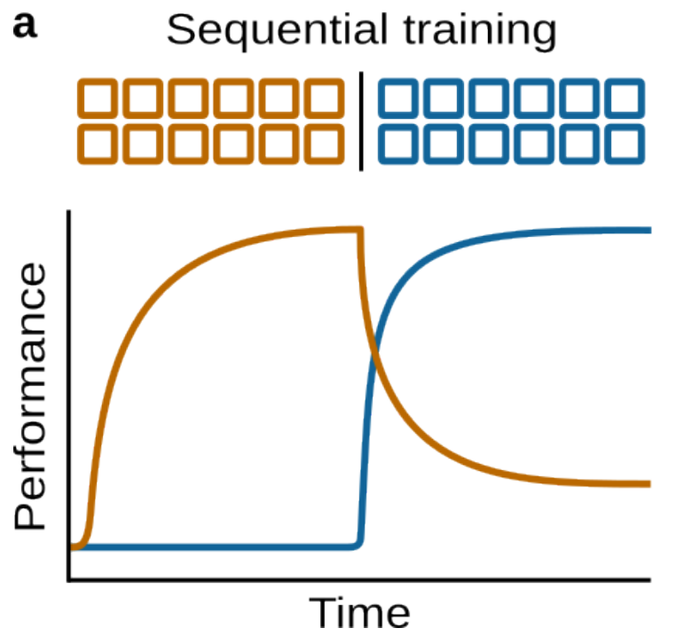
Catastrophic Forgetting
Neural networks forget previously learned tasks when trained on new ones.
Happens because weights are overwritten by new task-specific updates.
Catastrophic Forgetting [3]

Slide 6
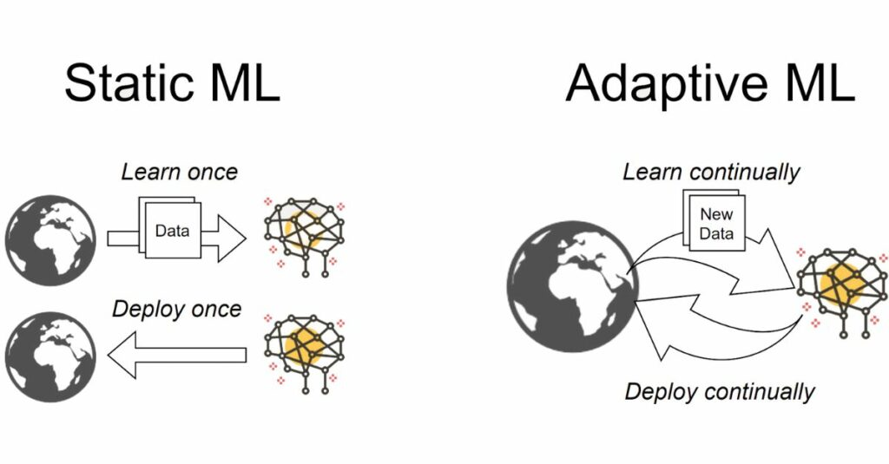
Continual Learning
Enables retaining knowledge across tasks.
Addresses non-IID data and catastrophic forgetting.
Static ML vs Adaptive ML [4]

Slide 7
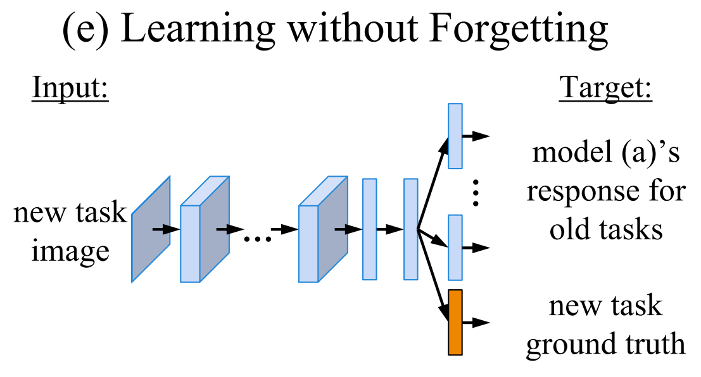
Learning Without Forgetting (LWF)
Retains knowledge via knowledge distillation (compares outputs of the previous and current model).
Works well for tasks with similar distributions.
LWF Architecture [5]

Slide 8
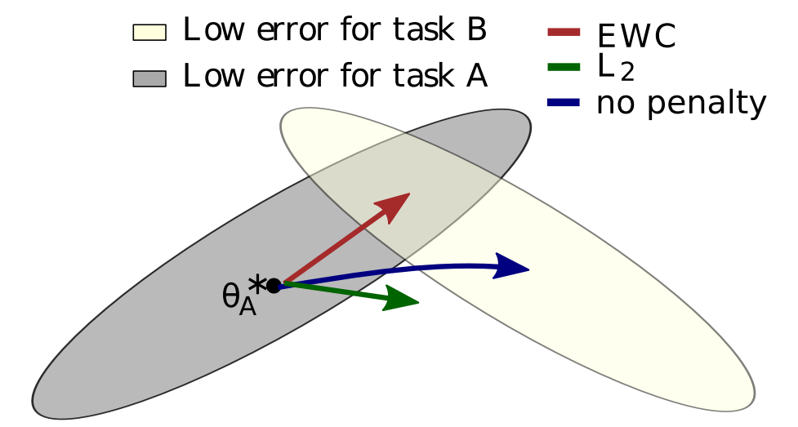
Elastic Weight Consolidation (EWC)
Adds a regularization term to the loss function to protect weights important for previous tasks.
Prevents forgetting by penalizing changes to key parameters.
EWC Task Balancing [6]

Slide 9
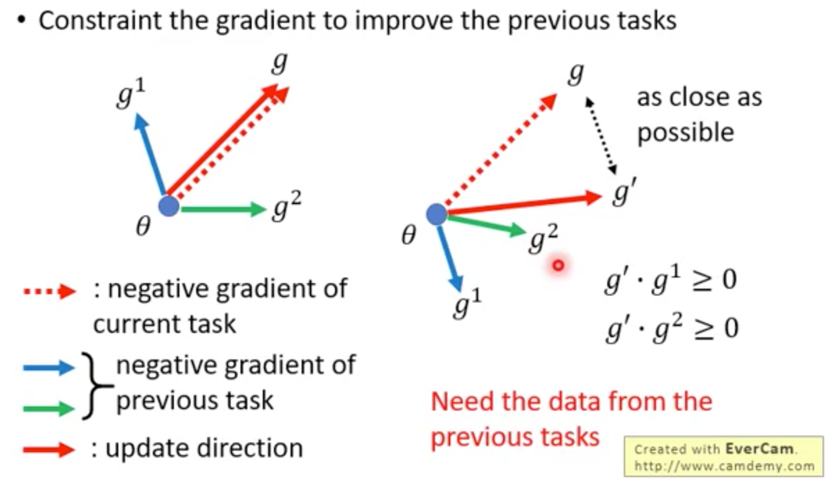
Averaged Gradient Episodic Memory (A-GEM)
Utilizes memory buffers to store samples from past tasks.
Ensures new gradients do not interfere with previous ones.
GEM [7]

Slide 10
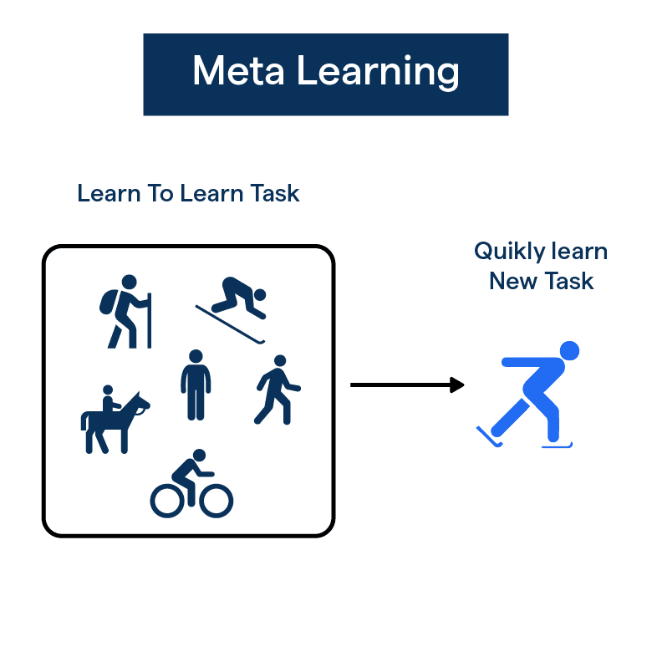
Meta-Learning
Enables models to adapt to new tasks with minimal data and retraining.
The model learns how to learn, rather than solving specific tasks directly.
Meta Learning [8]

Slide 11
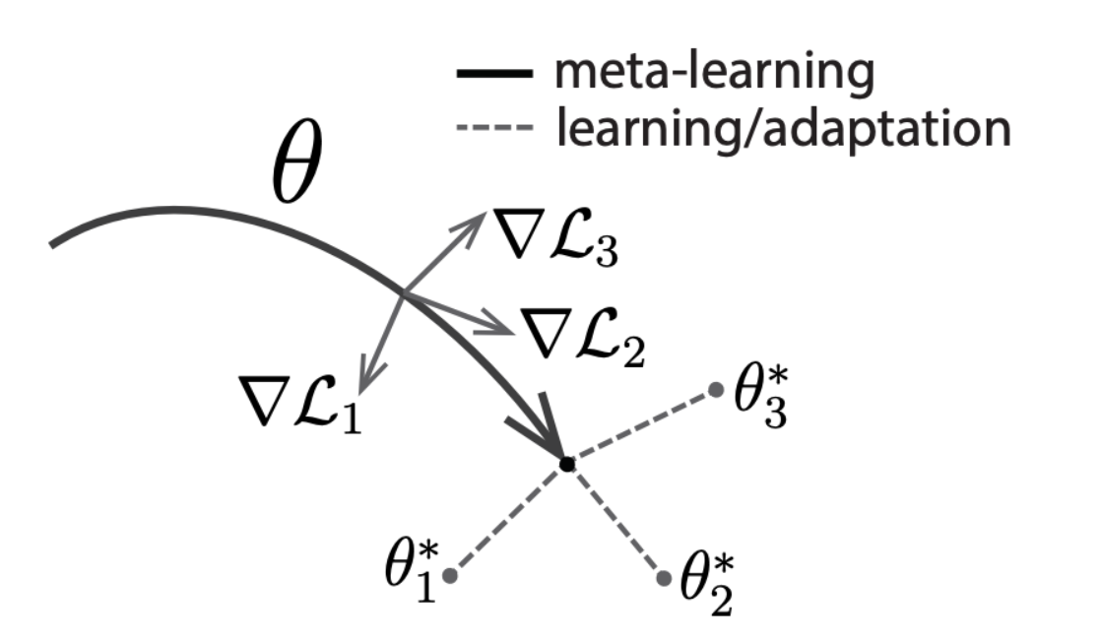
Model Agnostic Meta-Learning (MAML)
Learns optimal initialization for rapid adaptation to new data.
Uses inner loops for task-specific updates and outer loops for meta updates.
Optimizing parameters to quickly adapt to new tasks [9]

Slide 12
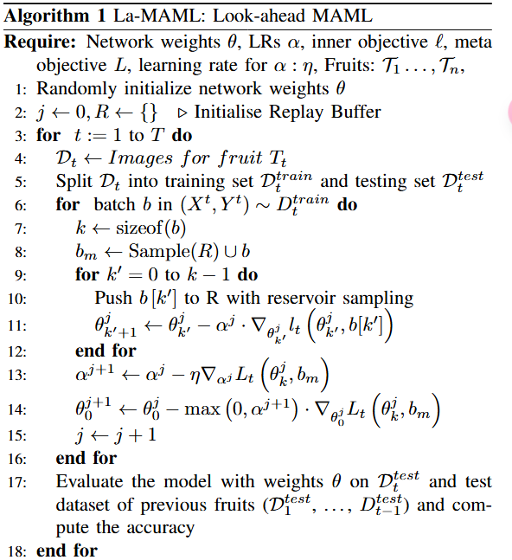
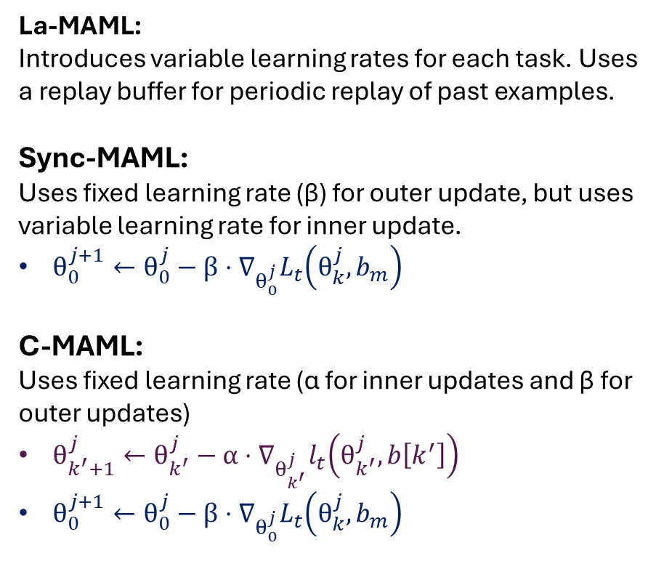
Look Ahead MAML and Its Variants
La-MAML:
Introduces variable learning rates for each task. Uses a replay buffer for periodic replay of past examples.
Sync-MAML:
Uses fixed learning rate (β) for outer update, but uses variable learning rate for inner update.
$θ_{0}^{j+1}←θ_{0}^{j}−β⋅∇_{θ_{0}^{j}}L_{t}\left(θ_{k}^{j},b_{m}\right)$
C-MAML:
Uses fixed learning rate (α for inner updates and β for outer updates)
$θ_{k^{′}+1}^{j}←θ_{k^{′}}^{j}−α⋅∇_{θ_{k^{′}}^{j}}l_{t}\left(θ_{k^{′}}^{j},b\left[k^{′}\right]\right)$
$θ_{0}^{j+1}←θ_{0}^{j}−β⋅∇_{θ_{0}^{j}}L_{t}\left(θ_{k}^{j},b_{m}\right)$
La-MAML Algorithm [10]

Slide 13
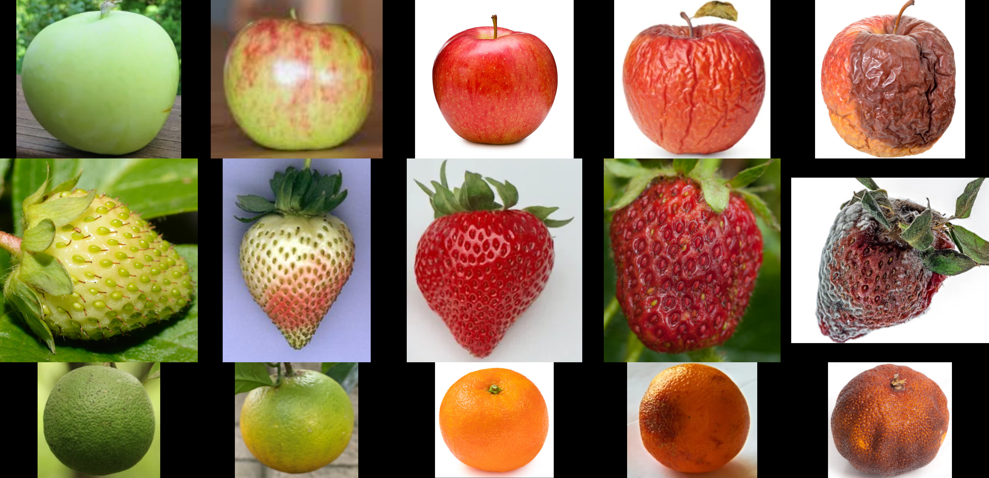
Dataset
The dataset consists of 14 fruits, each classified into 5 ripening stages (Unripe, Early ripe, Ripe, Overripe, Rotten).
Each stage is treated as a separate class, with 10 images per class, resulting in a total of 50 images per fruit.
The fruits are categorized into 7 climacteric fruits (Apple, Banana, Guava, Jackfruit, Mango, Papaya and Pear) and 7 non-climacteric fruits (Dragon fruit, Lemon, Lychee, Orange, Pineapple, Pomegranate and Strawberry).
All images are resized to 100x100 pixels. The dataset is evenly split into training and testing sets, with 5 images per class used for training and 5 for testing.

Slide 14
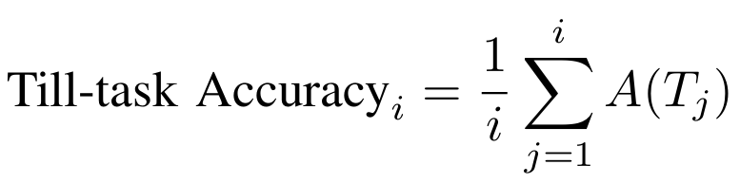
Metrics and Hypotheses
The metric used is ‘till-task accuracy’. It measures the accuracy of a model trained on the ith fruit by evaluating it on the test dataset comprising the current fruit and all previous fruits the model has been trained on.
H0: Meta-learning based continual learning approach outperforms generic continual learning approaches.
H1: Meta-learning based continual learning model trained specifically on fruits that share common degrading properties (climacteric fruits) will outperform a more general meta-learning based continual learning approach that is trained on all types of fruits.

Slide 15
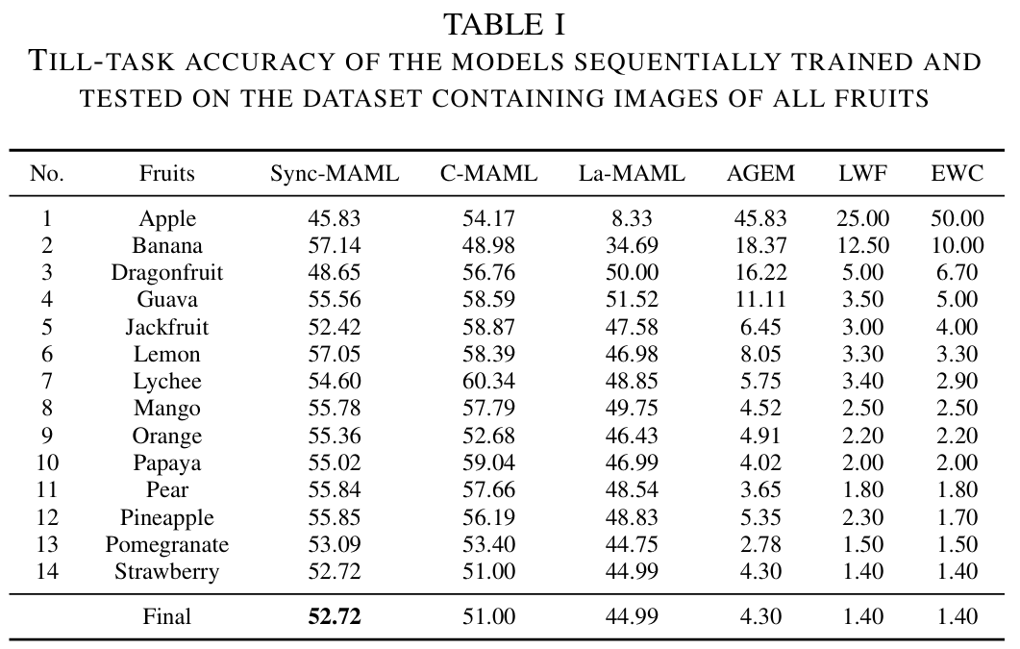
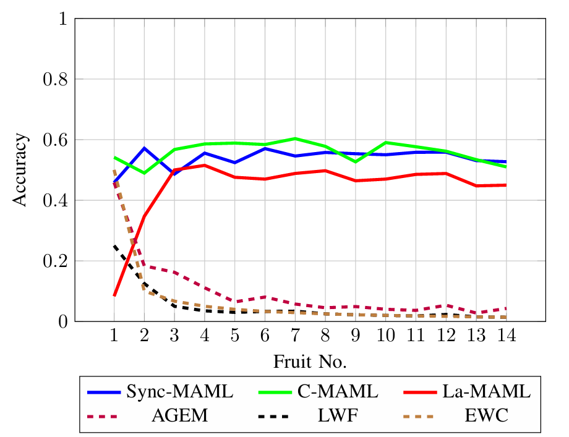
Results (For All Fruits)
Key Finding: Meta learning based Continual learning methods (Sync-MAML and C-MAML) outperform traditional Continual Learning methods under the assumption of limited training dataset.

Slide 16
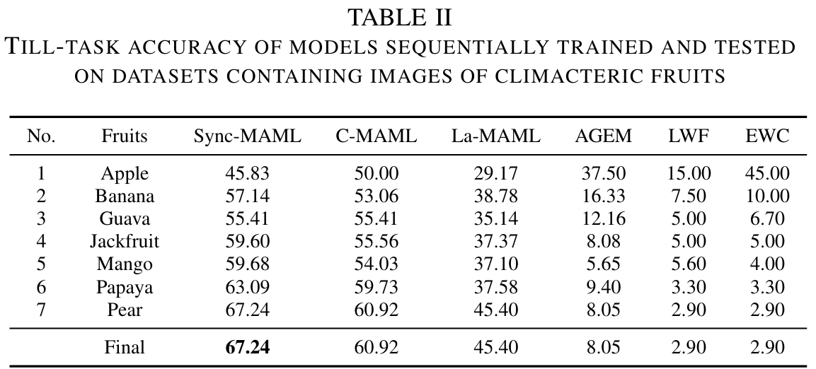
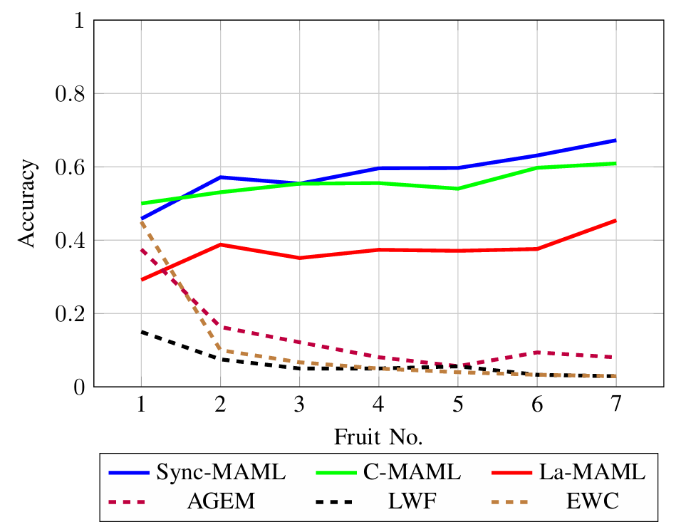
Results (For Only Climacteric Fruits)
Key Finding:
Meta learning based Continual learning methods (Sync-MAML and C-MAML) outperform traditional Continual Learning methods under the assumption of limited training dataset.
Climacteric fruits showed higher accuracy due to clearer ripening patterns.

Slide 17
References
https://www.worldbank.org/en/news/feature/2014/02/27/infographic-food-loss-waste
https://lamarr-institute.org/blog/deep-neural-networks/
Gido M. van de Ven, Nicholas Soures, & Dhireesha Kudithipudi. (2024). Continual Learning and Catastrophic Forgetting.
https://medium.com/continual-ai/towards-adaptive-ai-with-continual-learning-f493fd0d698
Zhizhong Li, & Derek Hoiem. (2017). Learning without Forgetting.
Kirkpatrick, J., Pascanu, R., Rabinowitz, N., Veness, J., Desjardins, G., Rusu, A., Milan, K., Quan, J., Ramalho, T., Grabska-Barwinska, A., Hassabis, D., Clopath, C., Kumaran, D., & Hadsell, R. (2017). Overcoming catastrophic forgetting in neural networks. Proceedings of the National Academy of Sciences, 114(13), 3521–3526.
https://zhangruochi.com/Lifelong-Learning/2020/03/14/

Slide 18
References
https://botpenguin.com/glossary/meta-learning
Chelsea Finn, Pieter Abbeel, & Sergey Levine. (2017). Model-Agnostic Meta-Learning for Fast Adaptation of Deep Networks.
Gunshi Gupta, Karmesh Yadav, & Liam Paull. (2020). La-MAML: Look-ahead Meta Learning for Continual Learning.

Slide 19
Thank You.

